Slide 1
Finite State Machines With Output
CSE 322
Formal Language and Automata Theory

Slide 2
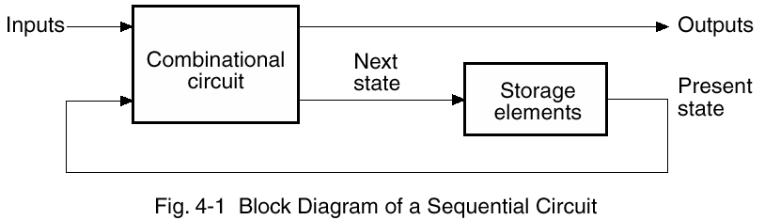
Today’s Topics
State Machines
  How to design machines that go through a sequence of events
    “sequential machines”
  Basically close the feedback loop in this picture:

Slide 3
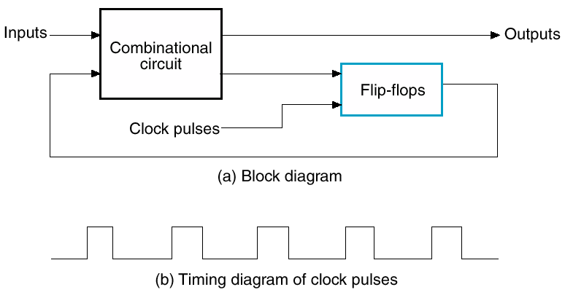
Synchronous Sequential Logic
Flip-flops/registers contain the system’s state
  state changes only at clock edge
    so system is synchronized to the clock
  all flip-flops receive the same clock signal (important!)
  every cyclic path must contain a flip-flop

Slide 4
Two common types
Two common synchronous sequential circuits:
  Finite State Machines (FSMs)
  Pipelines

Slide 5
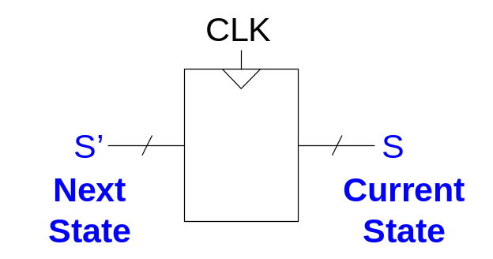
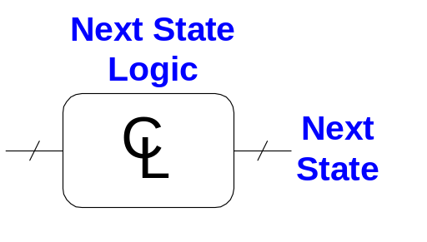
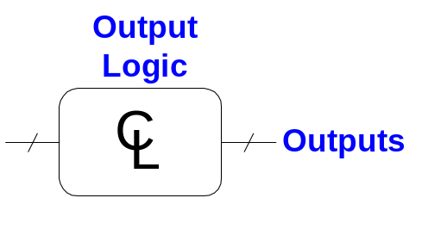
Finite State Machine (FSM)
Consists of:
  State register that
    holds the current state
    updates it to the “next state” at clock edge
  Combinational logic (CL) that
    computes the next state
      using current state and inputs
    computes the outputs
      using current state (and maybe inputs)

Slide 6
More and Mealy FSMs
Two types of finite state machines differ in the output logic:
  Moore FSM:
    outputs depend only on the current state
  Mealy FSM:
    outputs depend on the current state and the inputs
  can convert from one form to the other
    Mealy is more general
In Both:
  Next state is determined by current state and inputs

Slide 7
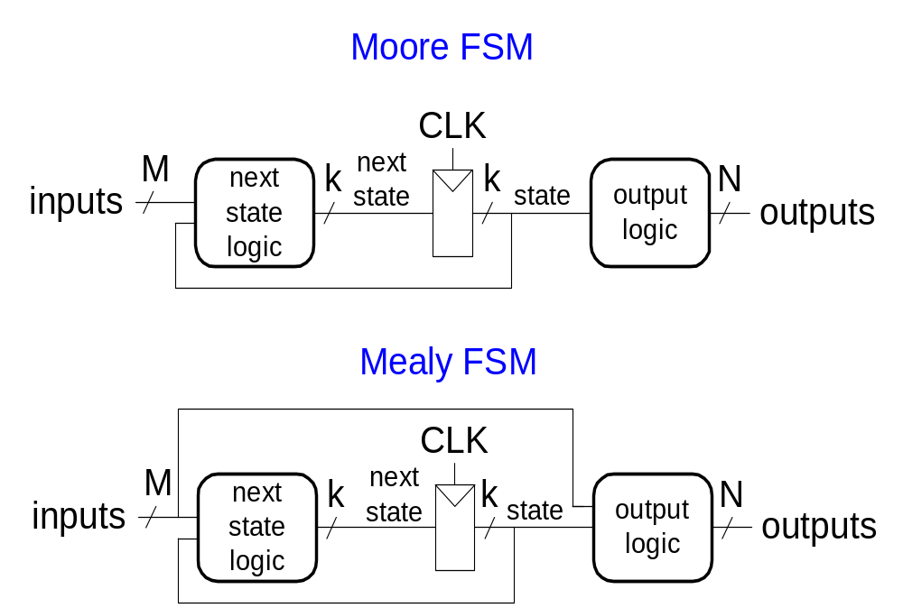
Moore and Mealy FSMs

Slide 8
Formal Definition of Moore Machine
Moore machines are finite state machines with output value and its output depends only on present state. It can be defined as (Q, q0, ∑, O, δ, λ) where:
Q is finite set of states.
q0 is the initial state.
∑ is the input alphabet.
O is the output alphabet.
δ is transition function which maps Q×∑ → Q.
λ is the output function which maps Q → O.

Slide 9
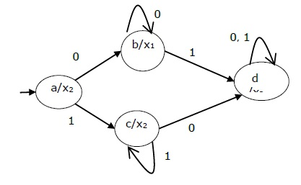
Representation method of Moore Machine

Slide 10
The state table of a Moore Machine is shown below −
Present state | Next State |  | Output
 | Input = 0 | Input = 1
→ a | b | c | x₂
b | b | d | x₁
c | c | d | x₂
d | d | d | x₃

Slide 11
Formal Definition of Mealy Machine
A Mealy Machine is an FSM whose output depends on the present state as well as the present input.
It can be described by a 6 tuple (Q, ∑, O, δ, X, q₀) where −
Q is a finite set of states.
∑ is a finite set of symbols called the input alphabet.
O is a finite set of symbols called the output alphabet.
δ is the input transition function where δ: Q × ∑ → Q
X is the output transition function where X: Q × ∑ → O
q₀ is the initial state from where any input is processed (q₀ ∈ Q).

Slide 12
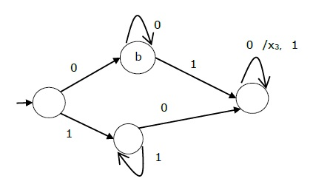
Representation method of Mealy Machine

Slide 13
The state table of a Mealy Machine is shown below −
Present state | Next state
 | input = 0 |  | input = 1
 | State | Output | State | Output
→ a | b | x₁ | c | x₁
b | b | x₂ | d | x₃
c | d | x₃ | c | x₁
d | d | x₃ | d | x₂

Slide 15
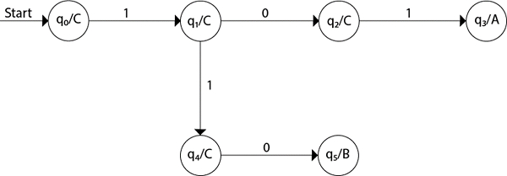
Designing of Moore Machine
Ex#1 :Design a Moore machine for a binary input sequence such that if it has a substring 101, the machine outputs A, if the input has substring 110, it outputs B otherwise it outputs C

Slide 16
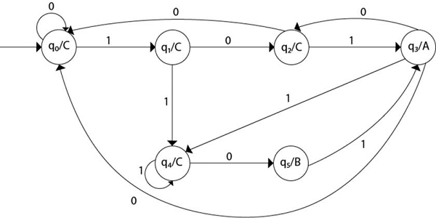
Ex#1

Slide 17
EX#2: Design a Moore machine to generate 1's complement of a binary number.
Explanation
Step 1 − q0 is the start state on input ‘0’ goes to q1 state and on ‘1’ goes to state q2 generating output 0.
Step 2 − q1 on input ‘0’ goes to q1 itself and on ‘1’ goes to q2 generating output ‘1’.
Step 3 − q2 on input ‘0’ goes to q1 and on ‘1’ goes to q2 generating output ‘0’.

Slide 18
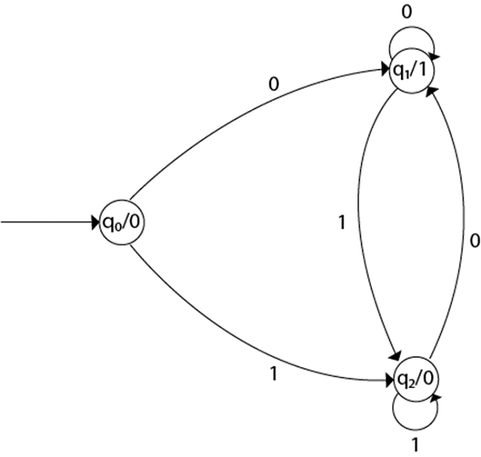
Ex#2:

Slide 19
Designing of Mealy Machine
Ex # 1 :Design a Mealy Machine that prints “a” whenever the sequence “01” is encountered in any input binary string.

Slide 20
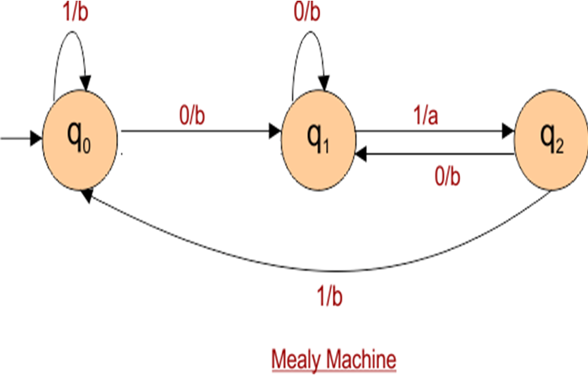
Solution of Ex#1

Slide 21
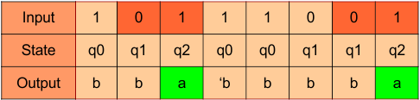
For Example : Take one binary number 10111001 then look at thetake one binary number 10111001 then look at the following table following table

Slide 22
Ex#2: Design a Moore machine to generate 1’s complement of a any given binary input.

Slide 23
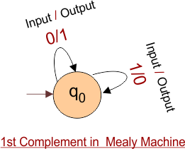
Solution of Ex#2:

Slide 24
Ex#3: Design a mealy machine to determine the residue mod 3 of a binary number.

Slide 25

Solution of EX#3

Slide 26
Equivalence in Moore and Mealy Machine
1. Conversion from Mealy to Moore
2. Conversion from Moore to Mealy

Slide 27
1. Conversion from mealy to moore
Mealy Machine to Moore Machine
Algorithm
Input: Mealy Machine
Output: Moore Machine
Step 1 Calculate the number of different outputs for each state (Qi) that are available in the state table of the Mealy machine.
Step 2 If all the outputs of Qi are same, copy state Qi . If it has n distinct outputs, break Qi into n states as Qin where n = 0, 1, 2.......

Slide 28
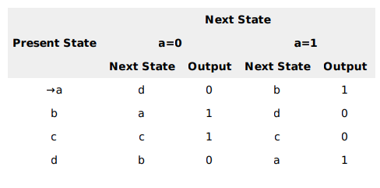
Example Let us consider the following Mealy Machine
Here, states ‘a’ and ‘d’ give only 1 and 0 outputs respectively, so we retain states ‘a’ and ‘d’. But states ‘b’ and ‘c’ produce different outputs 1and0. So, we divide b into b0, b1 and c into c0, c1.

Slide 29
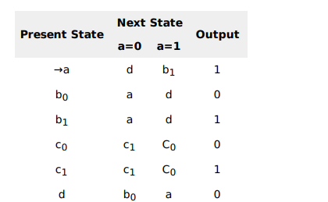
Now Draw the Transition Diagram of equivalent Moore Machine

Slide 30
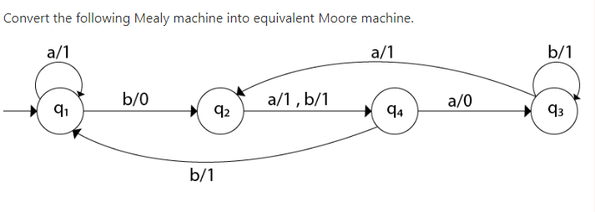
Ex#2:

Slide 31
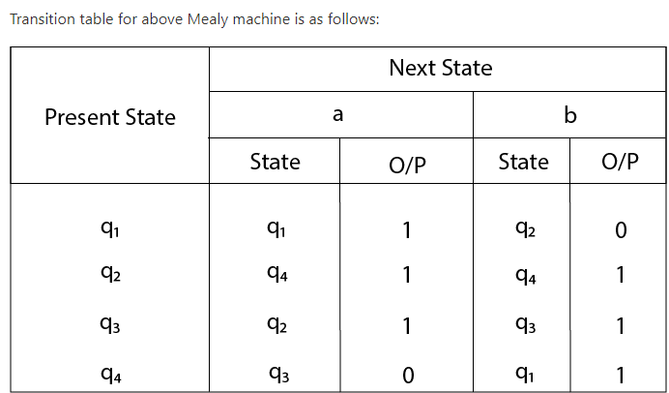

Slide 32
For state q1, there is only one incident edge with output 0. So, we don't need to split this state in Moore machine.
For state q2, there is 2 incident edge with output 0 and 1. So, we will split this state into two states q20( state with output 0) and q21(with output 1).
For state q3, there is 2 incident edge with output 0 and 1. So, we will split this state into two states q30( state with output 0) and q31( state with output 1).
For state q4, there is only one incident edge with output 0. So, we don't need to split this state in Moore machine.

Slide 33
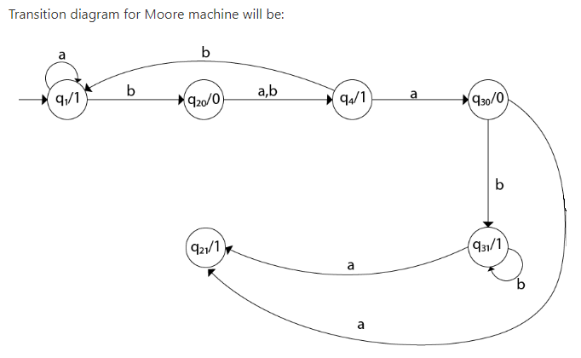

Slide 34
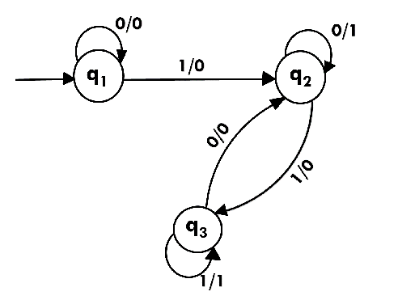
Ex# 3:

Slide 35
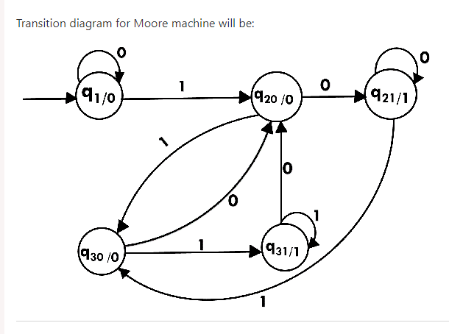
Solution

Slide 36
2. Conversion from Moore To Mealy
In the Moore machine, the output is associated with every state, and in the mealy machine, the output is given along the edge with input symbol. The equivalence of the Moore machine and Mealy machine means both the machines generate the same output string for same input string.
We cannot directly convert Moore machine to its equivalent Mealy machine because the length of the Moore machine is one longer than the Mealy machine for the given input. To convert Moore machine to Mealy machine, state output symbols are distributed into input symbol paths. We are going to use the following method to convert the Moore machine to Mealy machine.

Slide 37
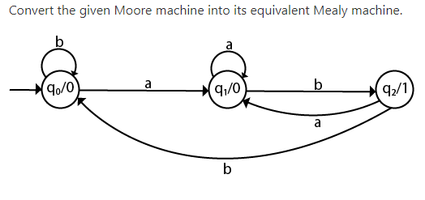

Slide 38
The equivalent Mealy machine can be obtained as follows:
λ' (q0, a) = λ(δ(q0, a))
= λ(q1)
= 0
λ' (q0, b) = λ(δ(q0, b))
= λ(q0)
= 0
The λ for state q1 is as follows:
λ' (q1, a) = λ(δ(q1, a))
= λ(q1)
= 0
λ' (q1, b) = λ(δ(q1, b))
= λ(q2)
= 1
The λ for state q2 is as follows:
λ' (q2, a) = λ(δ(q2, a))
= λ(q1)
= 0
λ' (q2, b) = λ(δ(q2, b))
= λ(q0)
= 0

Slide 39
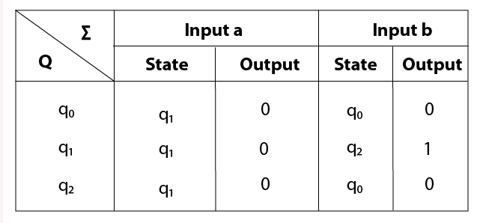
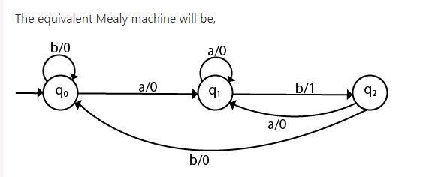

Slide 40
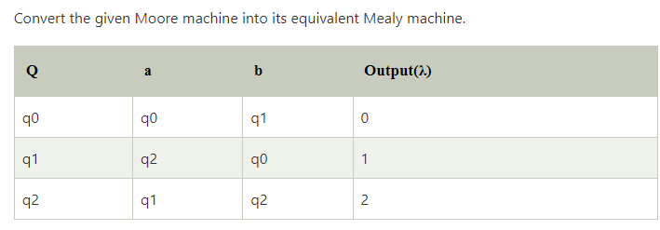
Ex#2:

Slide 41
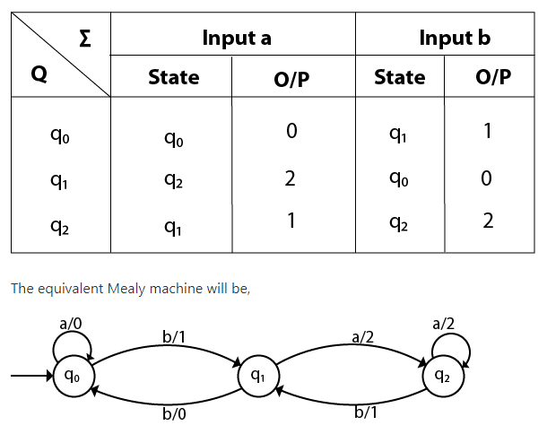
Solution of Ex#2

Slide 42
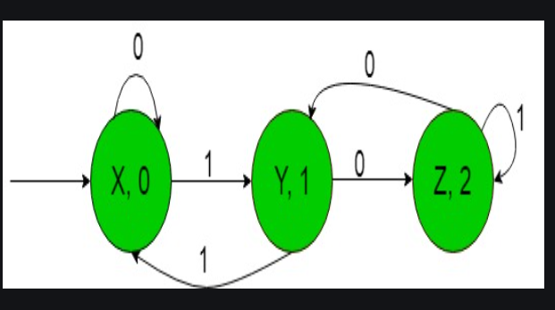
Ex#3:

Slide 43
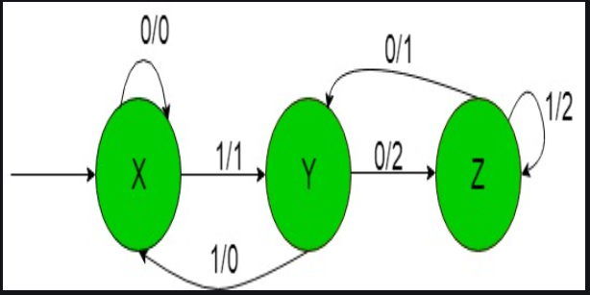
Solution of Ex#3

Slide 44
END of TOPIC
Thanks to All
Any Query ????

